Slide 1
Learning Objectives
• Insert schematic components.
• Annotate and edit schematic symbols.
• Assign catalog part number to components.
• Create parent-child relationship between components.
• Swap or update blocks.
• Insert components from the equipment, panel, and catalog lists.
• Add a new record in the Schematic Component or Circuit dialog box.
• Edit an existing record in the Schematic or Circuit dialog box.

Slide 2
INTRODUCTION
Schematic components are AutoCAD block with attributes such as TAG1, TAG2, DESC, RATING, LOC, INST, and so on
Components consist of visible attributes
INSERTING SCHEMATIC COMPONENTS
Ribbon: Schematic > Insert Components > Icon Menu drop-down > Icon Menu
Toolbar: ACE:Main Electrical > Insert Component
or ACE:Insert Component > Insert Component
Menu: Components > Insert Component
or Components > Multiple Insert > Multiple Insert (Icon Menu)
Command: AECOMPONENT
Figure 1 The Icon Menu drop-down

Slide 3
Figure 2 The Insert Component dialog box

Slide 4
Figure 3 The Insert Component dialog box displayed on choosing the Menu toggle button

Slide 5

Menu Area
JIC: Schematic Symbols Area
Menu
Up one level
Views
Recently Used Area
Display
Vertical
No edit dialog
No tag
Scale schematic
Scale panel
Type it
Always display previously used menu
Figure 4 The Views drop-down

Slide 6
Figure 5 The Drawing Properties dialog box

Slide 7
Figure 6 The Insert Component dialog box displaying the NFPA: Push Buttons area

Slide 8
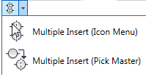
Figure 7 The Multiple Insert drop-down
INSERTING COMPONENTS USING Catalog Browser
Ribbon: Schematic > Insert Components >
Icon Menu drop-down > Catalog Browser
Command: AECATALOGOPEN

Slide 9
Figure 8 The Catalog Browser dialog box
Figure 9 The shortcut menu displayed

Slide 10
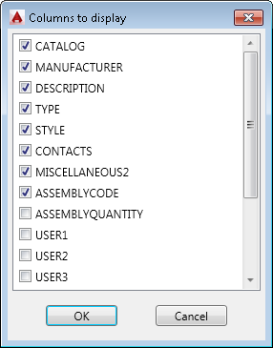
Figure 10 The Columns to display dialog box
Figure 11 The flyout displayed

Slide 11
Figure 12 The Bill Of Material Check dialog box
Figure 13 The Configure Database dialog box

Slide 12
Figure 14 The modified Configure Database dialog box

Slide 13
ANNOTATING AND EDITING THE SYMBOLS
Ribbon: Schematic > Edit Components > Edit Components drop-down > Edit
Toolbar: ACE:Main Electrical > Edit Component
or ACE:Edit Component > Edit Component
Menu: Components > Edit Component
Command: AEEDITCOMPONENT

Slide 14
Figure 15 The Edit Components drop-down
Figure16 The Insert / Edit Component dialog box

Slide 15
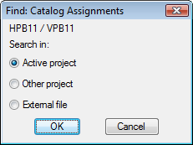
Component Tag Area
Catalog Data Area
Figure 17 The Option: Tag Format “Family” Override dialog box
Figure 18 The Find: Catalog
Assignments dialog box

Slide 16
Ratings Area
Figure 19 The View/Edit Rating Value dialog box
Description Area
Cross-Reference Area

Slide 17
Figure 20 The Cross-Reference Component Override dialog box

Slide 18
Figure 21 The Maximum NO/NC counts and/or allowed Pin numbers dialog box

Slide 19


Installation code and Location code Areas
Figure 22 The Installation code area
Figure 23 The Location code area

Slide 20
Show/Edit Miscellaneous
Figure 24 The Edit Miscellaneous and Non-AutoCAD Electrical Attributes dialog box

Slide 21
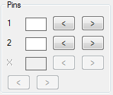
Pins Area
Figure 25 The Pins area
Switch Positions Area

Slide 22
Assigning the Catalog Information and Editing the Catalog Database
Figure 26 The Catalog Browser dialog box

Slide 23
Figure 27 The Catalog Browser - Edit Mode dialog box
Figure 28 The shortcut menu displayed

Slide 24
Creating a Project Specific Catalog Database
Figure 29 The Create Project-Specific Catalog Lookup File dialog box

Slide 25
CREATING PARENT-CHILD RELATIONSHIPS
Ribbon: Schematic > Insert Components > Icon Menu drop-down > Icon Menu
Toolbar: ACE:Main Electrical > Insert Component
or ACE:Insert Component > Insert Component
Menu: Components > Insert Component
or Components > Multiple Insert > Multiple Insert (Icon Menu)
Command: AECOMPONENT
Component Tag Area

Slide 26
Figure 30 The Insert / Edit Child Component dialog box

Slide 27
Figure 31 The Active Drawing list for FAMILY=“CR” dialog box

Slide 28
Figure 32 The Component List (this drawing only) dialog box

Slide 29
Figure 33 The Complete Project list for FAMILY=“CR” dialog box

Slide 30

Figure 34 The QSAVE message box

Slide 31
INSERTING COMPONENTS FROM THE EQUIPMENT
LIST
Ribbon: Schematic > Insert Components > Icon Menu drop-down >
Equipment List
Toolbar: ACE:Main Electrical > Insert Component >
Insert Component (Equipment List)
or ACE:Insert Component > Insert Component (Catalog List) >
Insert Component (Equipment List)
Menu: Components> Insert Component (Lists) >
Insert Component (Equipment List)
Command: AECOMPONENTEQ

Slide 32
Figure 35 The Insert Component (Equipment List) tool in the ACE:Main Electrical toolbar

Slide 33
Figure 36 The Select Equipment List Spreadsheet File dialog box

Slide 34
Figure 37 The Table Edit dialog box
Figure 38 The Settings dialog box

Slide 35
Default settings Read settings
View/Edit Settings Area Spreadsheet/Table columns
Figure 39 The Equipment List Spreadsheet Settings dialog box

Slide 36
Save Settings
Figure 40 The Schematic equipment in dialog box

Slide 37
Figure 41 The Sort Fields dialog box
Figure 42 The Insert dialog box

Slide 38
INSERTING COMPONENTS FROM THE CATALOG LIST
Ribbon: Schematic> Insert Components > Icon Menu drop-down > Catalog List
Toolbar: ACE:Main Electrical > Insert Component >
Insert Component (Catalog List)
or ACE:Insert Component > Insert Component (Catalog List)
Menu: Components> Insert Component (Lists) >
Insert Component (Catalog List)
Command: AECOMPONENTCAT

Slide 39
Sort by
Add
Edit
Delete
Figure 43 The Schematic Component or Circuit dialog box

Slide 40
Adding a New Record in the Schematic Component or Circuit Dialog Box
Figure 44 The Add record dialog box

Slide 41
Figure 45 The Add record dialog box with the Schematic and Explode (Circuit or panel assembly) radio buttons selected

Slide 42
Figure 46 The Add record dialog box with the Panel and Explode (Circuit or panel assembly) radio buttons selected

Slide 43
Figure 47 The Add New Record-Prefill with Defaults message box

Slide 44
Editing an Existing Record in the Schematic Component or
Circuit Dialog Box
Figure 48 The Edit Record dialog box

Slide 45
INSERTING COMPONENTS FROM PANEL LISTS
Ribbon: Schematic > Insert Components > Icon Menu drop-down > Panel List
Toolbar: ACE:Main Electrical > Insert Component >
Insert Component (Panel List)
or ACE:Insert Component > Insert Component (Panel List)
Menu: Components > Insert Component (Panel List)
Command: AECOMPONENTPNL

Slide 46
Figure 49 The Panel Layout List > Schematic Components Insert dialog box

Slide 47
Extract component list for Area
Installation Codes to extract Area
Location Codes to extract Area

Slide 48
Figure 50 The Panel Components dialog box

Slide 49
Sort List
Reload
Mark Existing
Display
Show All
Hide Existing
Catalog Check
Tag Options Area
Scale
Vertical
Pick File
Insert

Slide 50
Figure 51 The Spacing for Insertion dialog box

Slide 51
Figure 52 The Update other drawings? message box

Slide 52
SWAPPING AND UPDATING BLOCKS
Ribbon: Schematic > Edit Components > Swap/Update Block
Toolbar: ACE:Main Electrical > Insert Component >
Swap/Update Block
or ACE:Insert Component > Swap/Update Block
Menu: Components> Component Miscellaneous >
Swap/Update Block
Command: AESWAPBLOCK

Slide 53
Figure 53 The Swap Block / Update Block / Library Swap dialog box

Slide 54
Option A: Swap Block (swap to different block name) Area
Option B: Update Block (revised or different version of same block name) Area
Attribute Mapping Area

Slide 55
Figure 54 The Update Block - New block’s path\filename dialog box

Slide 56
Figure 55 The Library Swap All Drawing dialog box

Slide 57
Tutorial 1
In this tutorial, you will insert a ladder into the drawing with four rungs and then insert push buttons, relays, and pilot lights from the Insert Component dialog box. Also, you will add a description to components, as shown in Figure 56.
The following steps are required to complete this tutorial:
Create a new drawing as C05_tut01.dwg in the CADCIM project.
Insert ladder into the drawing.
3. Insert components and add descriptions to the components.
4. Add the wire.
5. Trim the Rung
6. Save and close the drawing file.

Slide 58
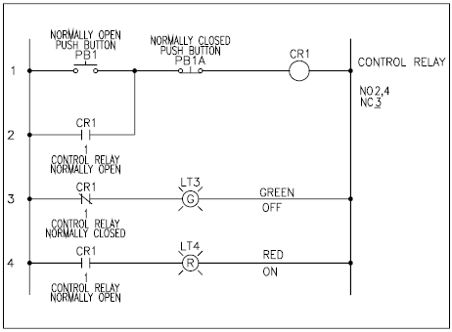
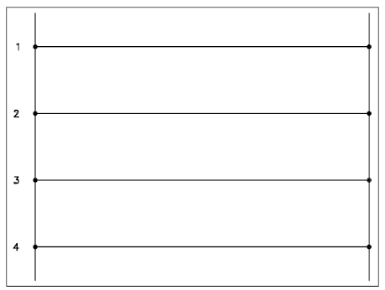
Figure 56 Ladder and components inserted in it
Figure 57 The ladder inserted in the drawing

Slide 59
Figure 58 The Insert Component dialog box

Slide 60
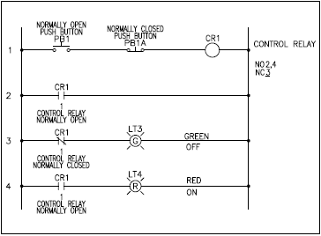
Figure 59 The ladder and components

Slide 61
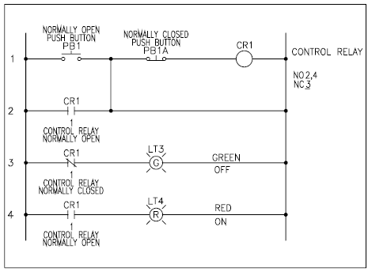
Figure 60 Wire inserted between rung 1 and rung 2

Slide 62
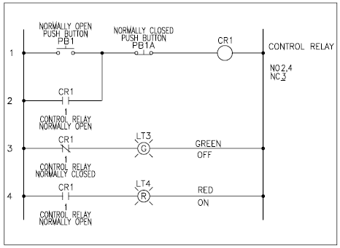
Figure 61 The ladder with the half portion of the rung 2 trimmed

Slide 63
Tutorial 2
In this tutorial, you will open the C05_tut01.dwg of Tutorial 1. Also, you will edit the component PB1 and add the catalog information to this component.
The following steps are required to complete this tutorial:
Open the C05_tut01.dwg file of the CADCIM project.
Save the drawing as C05_tut02.dwg.
Add the drawing to the CADCIM project list.
Edit the component PB1 and enter the catalog data.
Save and close the drawing file.

Slide 64
Figure 62 The Catalog Browser dialog box

Slide 65

Tutorial 3
In this tutorial, you will use the Swap/Update Block tool to swap a PB1A block with a limit switch LS1 that you have inserted in the drawing in Tutorial 1 of this chapter, as shown in Figure 63.
Figure 63 The push button PB1A swapped with the limit switch LS1

Slide 66
The following steps are required to complete this tutorial.
Open the drawing file C05_tut01.dwg.
Save the drawing as C05_tut03.dwg.
Add the drawing to the CADCIM project list.
Swap the block PB1A with the limit switch LS1 using the Swap/Update Block tool.
Save and close the drawing file.

Slide 67
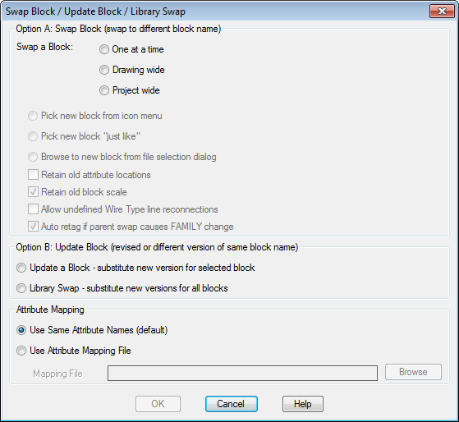
Figure 64 The Swap Block / Update Block / Library Swap dialog box

Slide 68
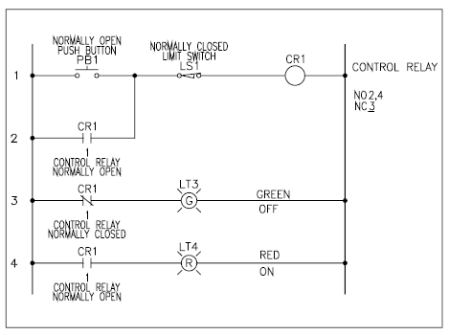
Figure 65 The push button (PB1A) replaced by the limit switch (LS1)

Slide 69
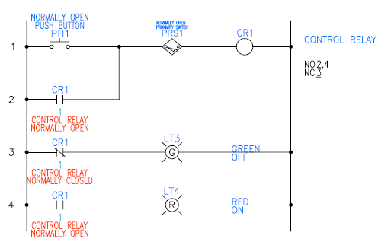
Tutorial 4
In this tutorial, you will change the symbol library setting from NFPA to JIC 125. Also, you will swap a limit switch LS1 that you have inserted in the drawing in Tutorial 3 of the NFPA library with a proximity switch PRS1 from the JIC 125 library, as shown in Figure 66.
Figure 66 The limit switch LS1 of the NFPA library changed to the proximity switch PRS1 of the JIC125 library

Slide 70
The following steps are required to complete this tutorial:
Open the drawing file C05_tut03.dwg.
Save the drawing as C05_tut04.dwg.
Add the drawing to the CADCIM project list.
4. Change the library NFPA to JIC125.
5. Swap the PRS1 to LS1.
6. Save and close the drawing file.

Slide 71
Figure 67 The Project Properties dialog box

Slide 72
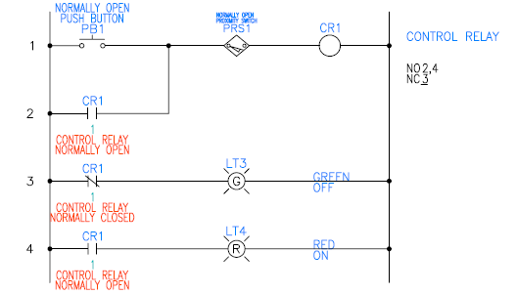
Figure 68 Limit switch LS1 swapped to proximity switch PRS1

Slide 73
Figure 69 The Create Project-Specific Catalog Database dialog box

